Slide 1

The Ethics and Economics of Environmental Protection
10. Climate change, reason, and the future of environmental protection
Notes:
Note: Revised lecture to reflect student questions in office hours.

Slide 2
A note on my approach
Reason
Theory
Institution
System
Problem
?
?
?
?
The world
Practice
Work
Mechanism
Solution

Slide 3
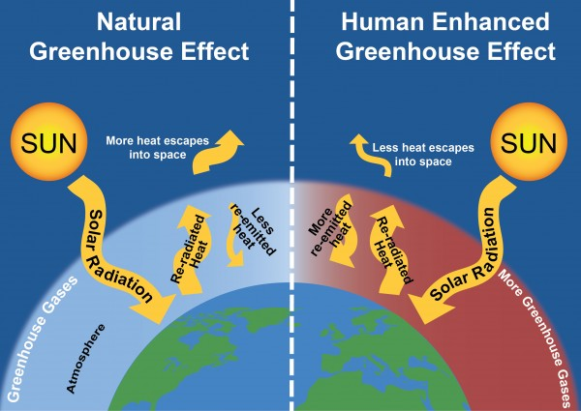
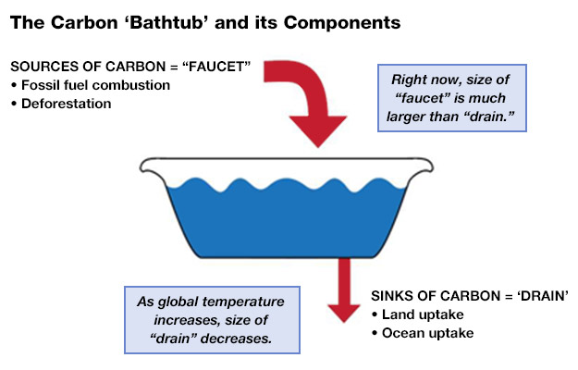
1. The basics

Slide 4

Why climate change is peculiarly complicated
SCIENTIFIC COMPLICATIONS
Climate change (CC) is hard to identify, because both “climate” and “change” are abstract notions;
The causes of CC can only be inductively confirmed, i.e., by simulating environmental changes, controlling for different variables, and seeing if real-world patterns emerge;
While identifying CC and attributing its causes is in the purview of modern physics, predicting how the climate will change in future is, at present, all but impossible.
HUMAN COMPLICATIONS
Our evolutionary endowments focus our attention on concrete, individual threats, not on abstract, potentially species-ending threats;
Our sense of empathy is peculiarly parochial; voters care deeply about co-nationals, but they seem unwilling to sacrifice personal gains for people in other countries;
Even our moral faculties seem poorly adapted; climate change will never kill anyone directly, but only by way of statistics, and (by and large) humans simply don’t understand statistics.

Slide 5
We have never faced a problem quite like CC before
Human population growth and social (capital) development
GHG emissions
Atmospheric and oceanic build-up
Key:
Red arrows indicate biophysical causes
Blue arrows indicate social causes
Climatic changes
Impacts on natural resource base
Impacts on human pop^{n}s and society

Slide 6
2. CC and limits—or, a summary of major themes
Malthusian limits
Promethean opportunities
Growth is the problem
Growth is the solution
Ethics, limits, change
Human interests largely exceed environmental values
Human interests largely coincide with environmental values
Uncertainty ensures that the future value of present investments cannot be assured; hence the discount rate should be low
Confidence in the market ensures that present investments will have a high value in future; hence the discount rate should be high
Climate change poses the same basic question as the “limits” debate

Slide 7
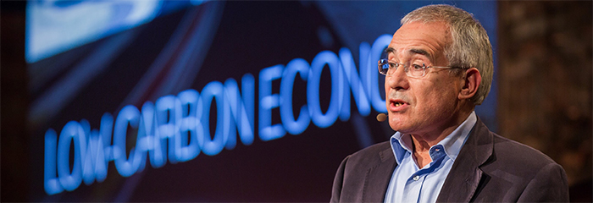
Market failure, economics, unintended consequences
Another way of thinking about climate change and growth involves identifying which of our institutions is responsible for unintended environmental harms
Is climate change a clear case of market failure?
  Since carbon is not efficiently priced (the social cost of consumption > private cost), individuals overconsume carbon-intensive activities (e.g., flying)
  The only response is to use command and control and/or market manipulation to ensure that consumers pay the full social cost of their decisions
Or is “climate change” a misleadingly concrete and pessimistic interpretation of the effects of human expansion and enrichment?
  First, the assertion that climate change is a “failure” indicates that we know we would have been better off following another course of action
  Second, market failure analysis suggests that we can readily identify and implement efficient solutions
Who recognises this glumbucket?

Slide 8
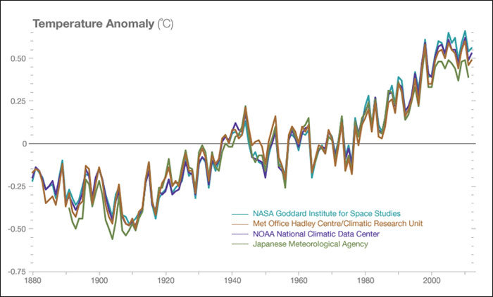
Risk, uncertainty, and ethics
The risks we face with regards climate change can be categorized thus:
Type 1 risks (false positives)
Type 2 risks (false negatives)
The risks we focus on, understandably, are type 2 risks
The current estimate is a 10% risk of a >6 degree global temp. rise
With each degree rise, the risk of disaster increases quadratically at best, exponentially at worst
But should we also worry about type 1 risks?
The elision of natural science with social science is commonplace
The reason seems to be the dominance of the neoclassical frame of explanation
Notes:
Orphaned:
A 10% or so chance that warming will exceed 6% on average
With each degree rise, the risks of natural disasters and resource collapse increases quadratically at best, exponentially at worst
Using Wallace-Well’s term, the problem here is one of cascades
Deadly heat waves
Agricultural instability
Rising sea levels
Uncontrollable wildfires
Freshwater depletion
Loss of marine biodiversity
Economic collapse
Resource conflicts

Slide 9
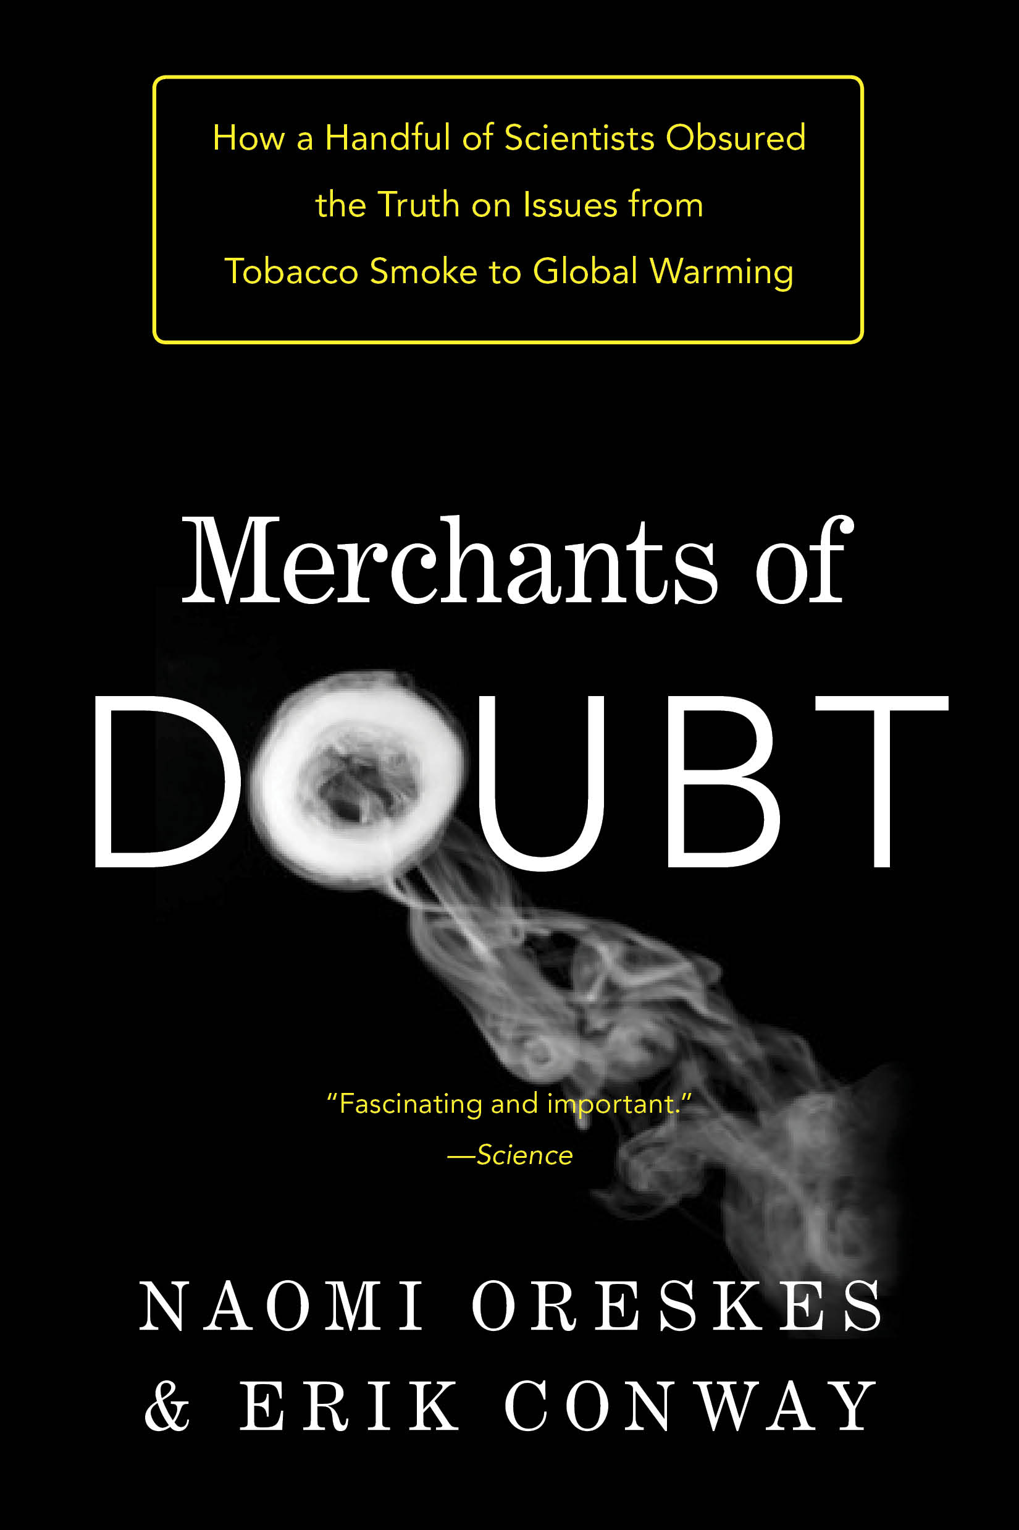
Risk, uncertainty, and ethics
The risks we face with regards climate change can be categorised thus:
Type 1 risks (false positives)
Type 2 risks (false negatives)
The risks we focus on, understandably, are type 2 risks
The current estimate is a 10% risk of a > 6 degree global temp. rise
With each degree rise, the risk of disaster increases quadratically at best, exponentially at worst
But should we also worry about type 1 risks?
The elision of natural science with social science is commonplace
The reason seems to be the dominance of the neoclassical frame of explanation

Slide 10
3. Reason and climate change: a couple in serious need of marriage counselling
There is a wide gulf between the scale of the challenge, and the capacity of reason
Consider how we might define climate change:
  “The greatest and most wide-ranging market failure ever seen”
  An injustice, largely perpetrated by the world’s rich on the poor
  An unintended consequence of human population growth
  A catastrophe that demonstrates the hubris and arrogance of humanity
  A metaphor for a number of interconnected, long-term, socio-biophysical changes
Which of these is the appropriate definition depends on:
Our values
Our economic capacity

Slide 11

Reason and action
Deontological reason
C.C. is a catastrophe; solution: rights-based ecological retrenchment
C.C. is a black swan with fat tails, the solution is unclear
C.C. is an injustice; solution: deliberative democracy
This is the economic continuum
Collectively motivated
Individually motivated
This is the ethical continuum
C.C. is a market failure; solution:
State intervention
C.C. is a (mere) UC; solution: innovation
Utilitarian reason

Slide 12
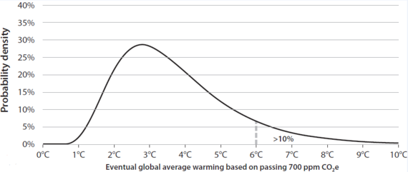
Fat tails
The thin tail
The fat tail

Slide 13

Final summary
Environmental protection is concerned with solving problems, and just to that extent it is tied up with the ethical question of what problems we face, and the economic question of how, if at all, we can solve them
Humanity faces undeniable limits—environmental scarcity ensures that we simply cannot have everything we want
But is this any different from the more general scarcity problem that economists have emphasised for hundreds of years? Are the limits we face primarily ecological—or do they relate to our ability to find social rules and institutions we might devise to deal with any kind of scarcity (including the scarcity of knowledge and empathy?)
The headline finding in environmental protection debates is that people disagree on every dimension of the challenge—every dimension, that is, except the question of whether there is a challenge
Most importantly, we face the question of reason: people’s interpretations of the world and its problems tend to be idiosyncratic, reflecting their individual experiences (and the media they have been exposed to). How, if at all, can we achieve consistency across these beliefs?
Second, we face the question of mechanisms: we can all dream up perfectly sustainable castles in the sky, but can we make them real in the world?
This is starkly revealed by climate change: all serious thinkers except it is real, but they disagree about the risks it faces (the mutual obligations it triggers) and how we can effectively minimise these risks (how the economy works)
Is climate change a clear failure of people to include obvious environmental values in their individual decisions (a market failure) or does it reflect the fact that environmental values—which depend on everyone’s behaviour—are fundamentally obscure to the individual (which raises the possibility of state failure)?
Might the primary lesson of climate change be the ethical one, that to have allowed ourselves to go down the utilitarian path, that our reason cannot support, was a mistake? But if so, what, if anything, does this recommend we do about climate change?

